Slide 1
White Wines -
How Ratings Effect Prices
Below $100
Presented by:
Regan Maher
Kristian Soriano
Rosalind White

Slide 2


Contents
Presentation Question
Data Overview
Data Clean Up/Limitations
Interesting Questions and Discoveries
World Look at Data
Country Results Based on Ratings
Varietal Results Based on Ratings
Pricing Impacts of Ratings
Binned Pricing Analysis
Conclusions and Analysis
Post Mortem
Questions

Slide 3
Presentation Questions
Do wine ratings have an impact on the wine price?
Do lower price points rate lower than higher price points?
What impact does variety and country have on ratings?

Slide 4


Data Overview/Usage
Kaggle – We utilized Kaggle to choose a CSV data set that would allow us to analyze a white wine data set based on price and ratings
Google Places – Utilized Good API to visually represent the various regions of White Wines represented in this dataset

Slide 5
Data – Clean Up/Limitations
Clean Up
Reviewed the data and fields
Count of Records
Dropped any records missing information
Dropped duplicates from the list by First
Dropped any wines priced over $100
Binned the price points into five buckets from $0-$100
Hard code the countries to the regions
Limitations
Dataset had limited geographic information
Google Places generated coordinates based on first search result and not necessarily the best choice
Some region not formatted correctly and one row was unable to grouped with others of the same name
No clear indication on the method of how the wine is rated

Slide 6
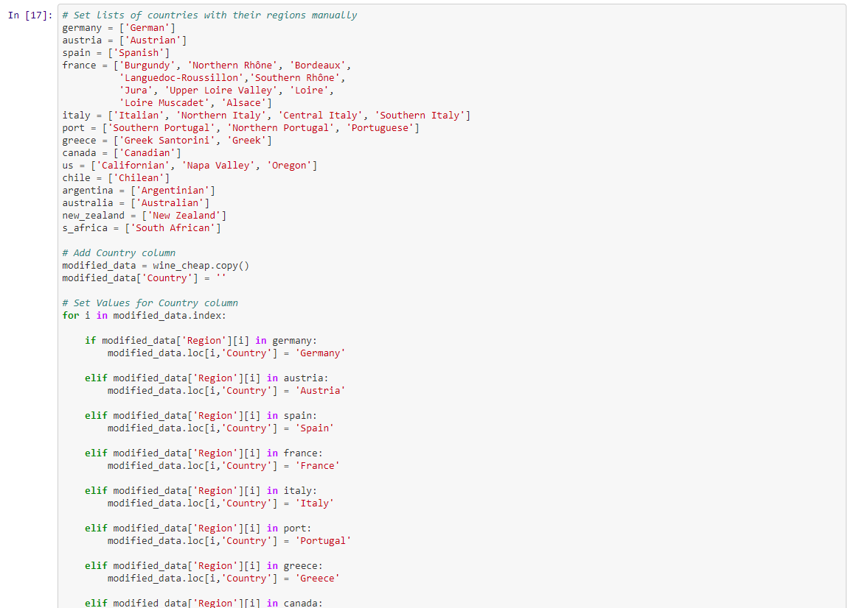
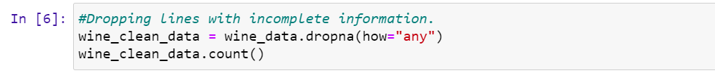
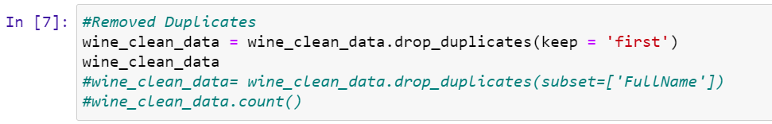
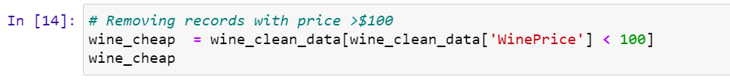
Data – Clean Up/Limitations
- Code examples
Below are some of the code clean up examples done.
Dropping missing rows
Dropping duplicates
Choosing only wines under 100
Hard coding the countries.

Slide 7


Interesting Questions and Discoveries
Regional location of the wines
Varietal range
High end wines
Slight difference of ratings between $50 - $100 wines

Slide 8
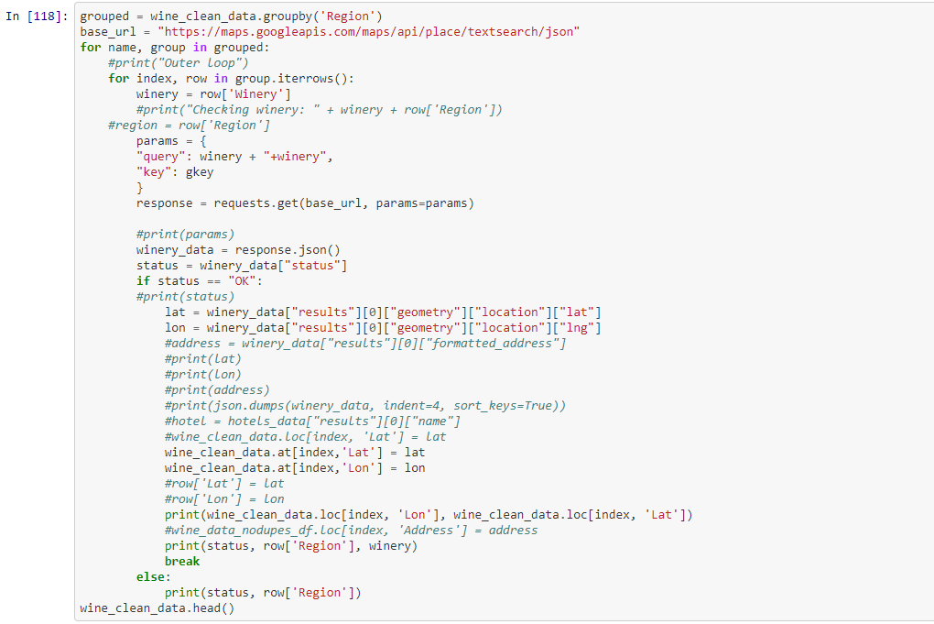
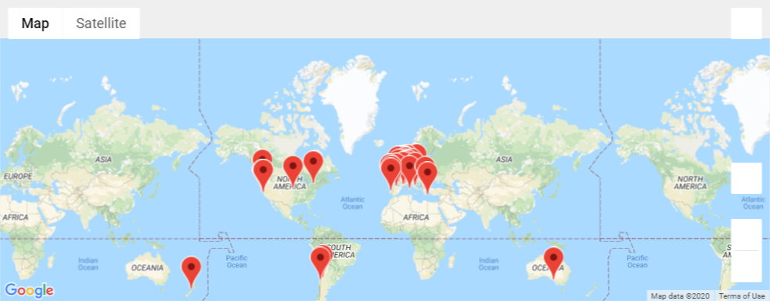
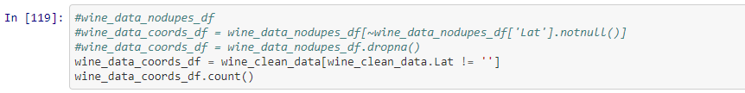
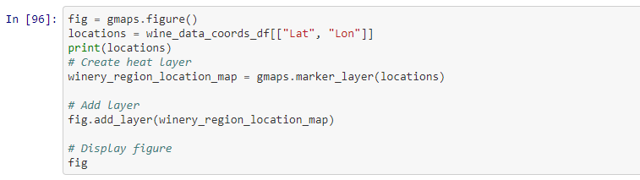
World Look at Data

Slide 9
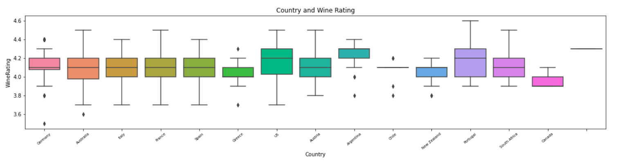

Country Results Based on Ratings

Slide 10
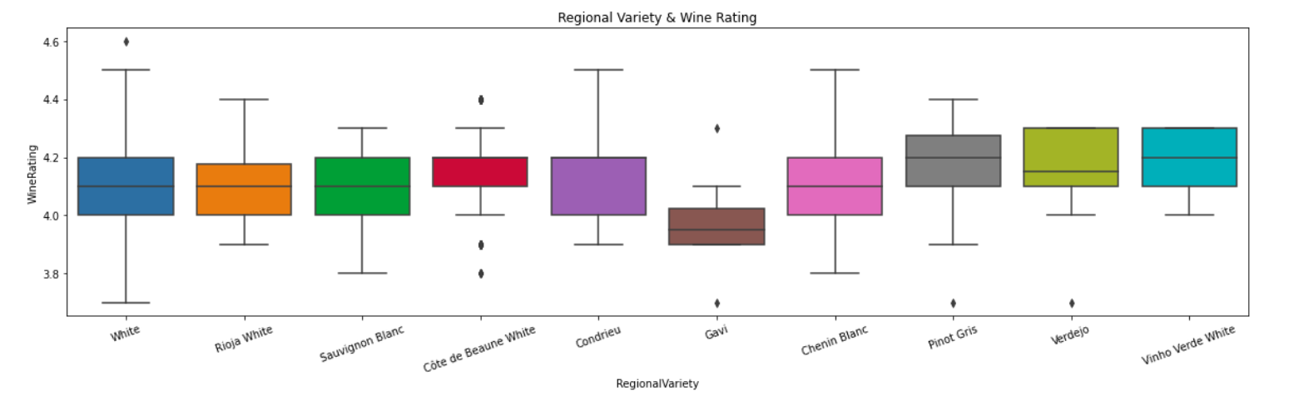

Varietal Results Based on Ratings
Top 10 Varieties
Please Note: There are 31 notable varieties included in this dataset and for the graph above the top 10 were chosen based on overall rating for visual purposes.

Slide 11
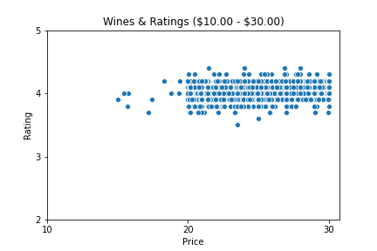
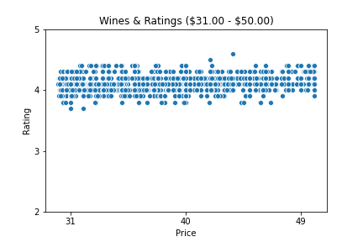
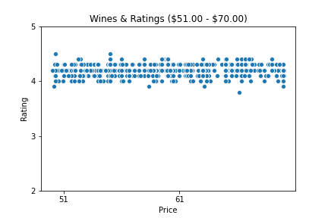
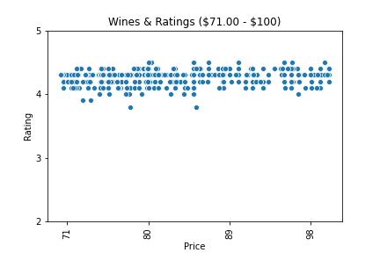
Pricing Impacts of Ratings

Slide 12
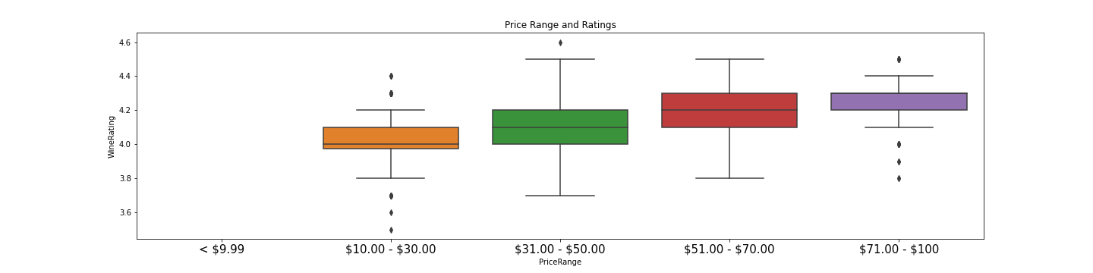
Pricing Impacts of Rating

Slide 13
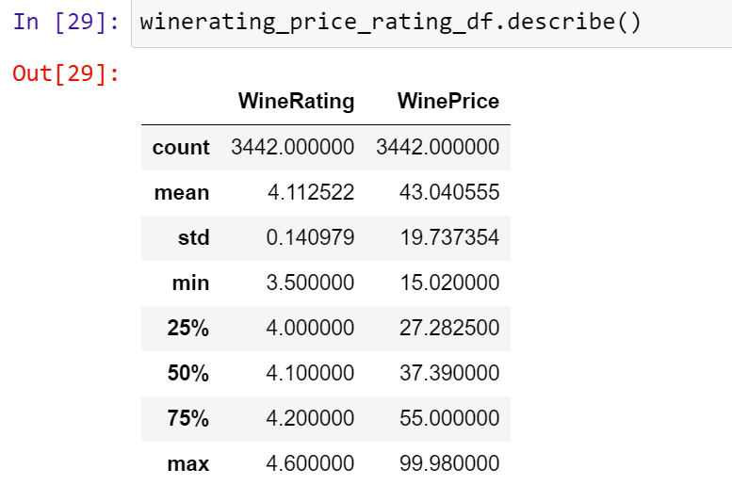
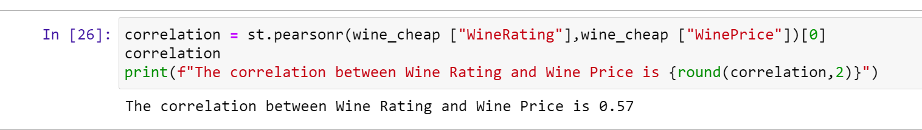
Conclusion and Analysis
For wines under $100 the statistics break down as follows.
  Average Wine Rating: 4.11 (wine average cost $43.04)
  Lowest Rating: 3.5 (cheapest wine $15.02)
  Highest Rating: 4.6 (expensive wine $99.98)
  Pearson’s r Rating: 0.57
There is some correlation between the price of a wine and how it is rated.

Slide 14
Post Mortem
Rates and Prices – Conduct a more detailed analysis similar to the overall price vs rate based on the following
  Regional Varieties
  Country
  Individual Regions
  Year
Red Wine – Similar Stats to see if the same holds true
Vintage Wine Ratings and Price
Marketing/Packaging Impact on Rates

Slide 15

Questions

